Slide 1
GAK Knowledge Transfer Group Overview of KTG activities
ITACA Kick-Off Meeting
Napoli, 29-30 November 2012
Laszlo Gabor Papocsi Dr
GAK Nonprofit Public Benefit Ltd
Gödöllő - Hungary

Slide 2
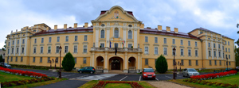
Founder and main owner of GAK
Szent István University (SZIU), one of Hungary’s most prominent institutions of higher education, consists of seven different faculties for study and research hosting approximately 19,000 students.

Slide 3
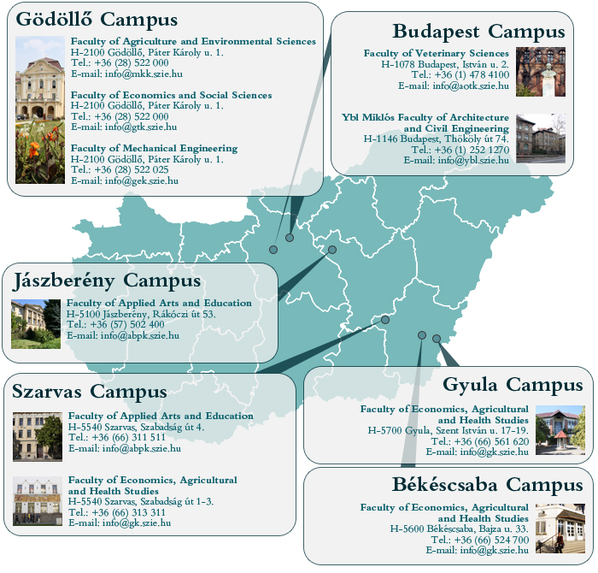

Slide 4
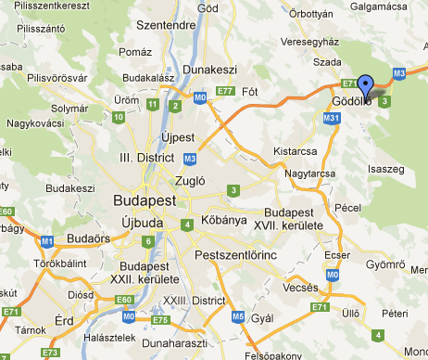
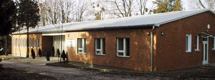
GAK
Founded in 1995.
Technology transfer (university->practise)
Innovation, research, advice, adult education, information system, marketing.
Near Budapest

Slide 5
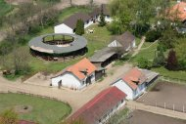
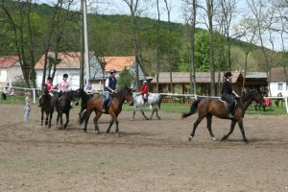
Groups
University related activities
Running the Demonstration and VET Farms
Plant production, cattle breeding, dairy farm, horticulture, bio-garden, horse stud etc
Operating the student hostels
Equal opportunity, social diversity projects
Knowledge transfer (rural/agri) activities and projects

Slide 6
GAK KTG Activities
Projects
EU FP6, eContent, Leonardo,…
FAO / knowledge dissemination
National: Netready, Innolearn, etc
Basic activities
CAP Farm Advisory Centre: 2007 (80%refund)
National accreditation in adult education: 2012
CAP/NRDP Farmer Training Centre: 2012 (100%refund)
CAP = Common Agricultural Policy of the EU
NRDP = National Rural Development Programme

Slide 7
GAK KTG Clients
Advisory system: 500/year
Farm diary software users:+500
Adult education: 200-1000/year
Members (founders): 20

Slide 8
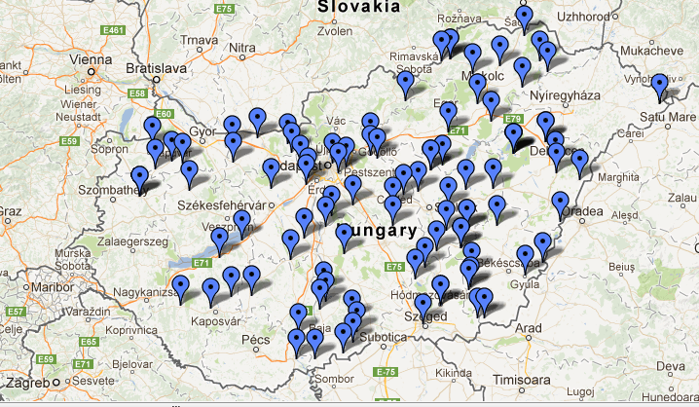
National coverage – KTG Partners: Top 100

Slide 9
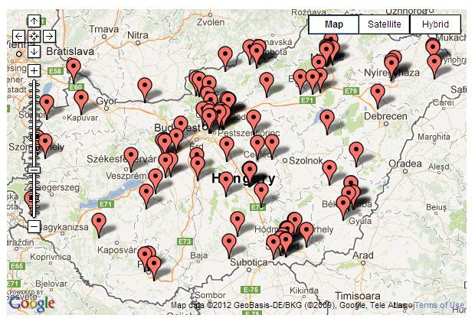
National coverage - Advisory Network

Slide 10
Practical/vocational trainings
NET-READY 2008, basic PC/Internet training, 3500 participants
CAP/RDP basic PC/Internet training course (100% refund, 40hours, code: an8)
FARMER-NET 2013- basic PC/Internet training
ECOVOC

Slide 11
Most IT related agricultural/rural development organisation in Hungary
Electronic/web based own workflow in
communication
contract system
E-Submission of
Land based Claims (eFarmer, eSAPS)
Geo-information, GPS, Precise farming
Monitoring
Farmer’s diary & other sofwares developed in-house
Climate change
Online meteorology sensor networks
Lightning detection
etc

Slide 12
Contact
Laszlo Gabor Papocsi Dr
Head of GAK KT Group
lpapocsi@gak.hu
www.gak.hu
Tel: +36 28 522-940

